Slide 1
Laplace Transform Analysis
Linear Circuit Analysis II
EECE 202 – Spring 2025

Slide 2
Announcement
Project Proposal will be released next week
Form project groups.
Quiz during Week 4

Slide 3
Recap
Introduction to basic signals
New Material
Laplace transform analysis
Properties of LaPlace transform
Examples

Slide 4
Learning Outcomes
2. an ability to compute responses of linear circuits with and without initial conditions via one-sided Laplace transform techniques. SO [1]

Slide 5
Laplace Transform Analysis
Laplace transform analysis technique transforms the time domain analysis of circuit, system, or differential equation to the frequency domain thus making it easier to solve.
Input Signal
Circuit
(Differential Equation)
Output Signal
LT of Input Signal
Laplace Transform (LT) of Circuit
(Differential Equation)
Output Signal in Laplace domain

Slide 6
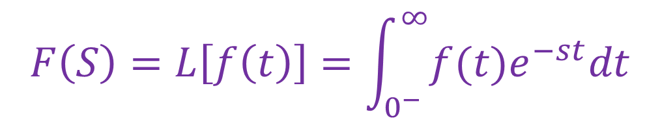
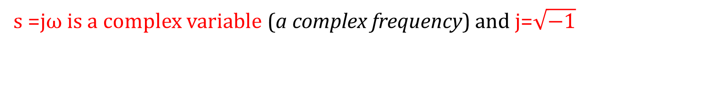
Laplace Transform Analysis
The one-side Laplace Transform of a Signal, a Function, or an Excitation is given by:
$$F\left(S\right)=L\left[f\left(t\right)\right]=\int_{0^{−}}^{∞}{f(t)e^{−st}dt}$$
s =jω is a complex variable (a complex frequency) and j=$\sqrt{−1}$
F(s) is the frequency domain counterpart of f(t).
Analysis using Laplase transforms is often called frequency domain analysis.

Slide 7
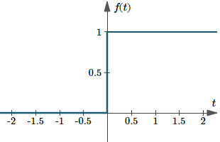
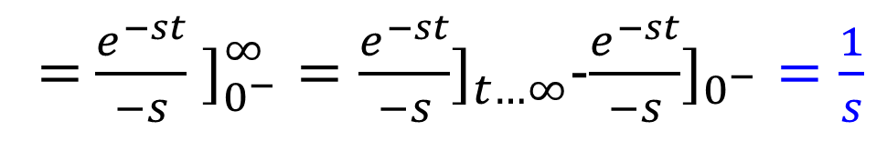
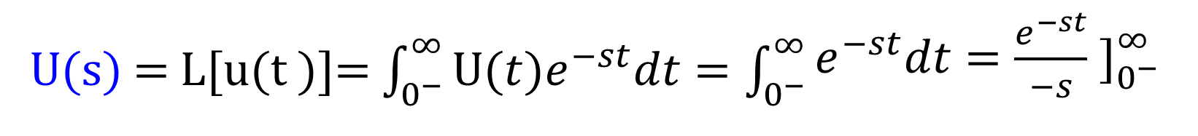
Example 12.4 (p. 556)
Find the Laplace tranform of the unit step U(s)
U(s) = L[u(t )]= $\int_{0^{−}}^{∞}{\text{U}(t)e^{−st}dt}=\int_{0^{−}}^{∞}{\begin{aligned}e^{−st}dt=\frac{e^{−st}}{−s} ]_{0^{\begin{aligned} \\ −\end{aligned}}}^{∞} \\ \end{aligned}}$
= $\frac{e^{−st}}{−s} ]_{0^{\begin{aligned} \\ −\end{aligned}}}^{∞}=\frac{e^{−st}}{−s}]_{t…∞}$-$\frac{e^{−st}}{−s}]_{0^{−}}=\frac{1}{s}$

Slide 8
salman
Example 12.4 (p. 556)
Find the Laplace tranform of the unit step U(s)
Unit Step function u(t) ={
t≥0
0 t<0
U(s) = L[u(t )]= $\int_{0^{−}}^{∞}{\text{U}(t)e^{−st}dt}=\int_{0^{−}}^{∞}{\begin{aligned}e^{−st}dt=\frac{e^{−st}}{−s} ]_{0^{\begin{aligned} \\ −\end{aligned}}}^{∞} \\ \end{aligned}}$
= $\frac{e^{−st}}{−s} ]_{0^{\begin{aligned} \\ −\end{aligned}}}^{∞}=\frac{e^{−st}}{−s}]_{t…∞}$-$\frac{e^{−st}}{−s}]_{0^{−}}=\frac{1}{s}$

Slide 9
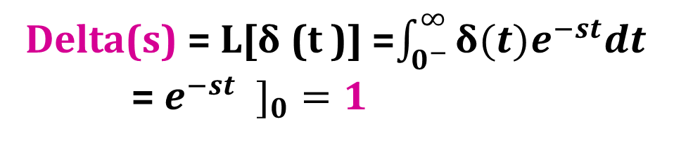
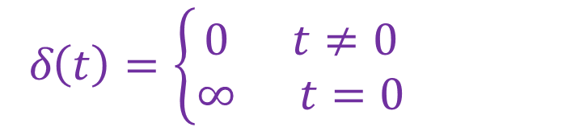
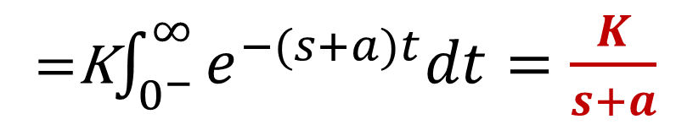
Example 12.5 (p. 557)
Find F(s) for f(t)=Ke^{-at} u(t)
F(s) = L[K e^{-at} u(t)]= $\int_{0^{−}}^{∞}{\text{K} \text{e}\text{−}\text{at}u(t)e^{−st}dt}=\int_{0^{−}}^{∞}{\text{K} \text{e}\text{−}\text{at}e^{−st}dt}$
=K$\int_{0^{−}}^{∞}{e^{−(s+a)t}dt}=\frac{K}{s+a}$
Example 1
Find Delta (s)
Recall Delta function (or Impulse function)
Delta(s) = L[δ(t)]
δ$\left(t\right)=\left\{\begin{aligned}0 t≠0 \\ ∞ t=0\end{aligned}\right.$
Delta(s) = L[δ (t )] =$\int_{0^{−}}^{∞}{\text{δ}(t)e^{−st}dt}$
= $e^{−st} ]_{0}=1$

Slide 10
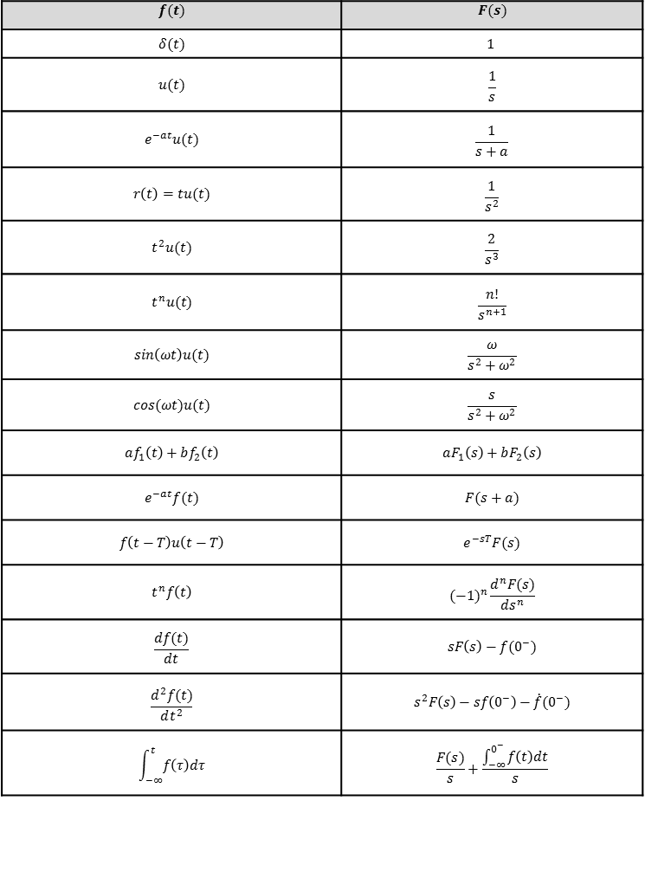
Properties of Laplace Transform

Slide 11
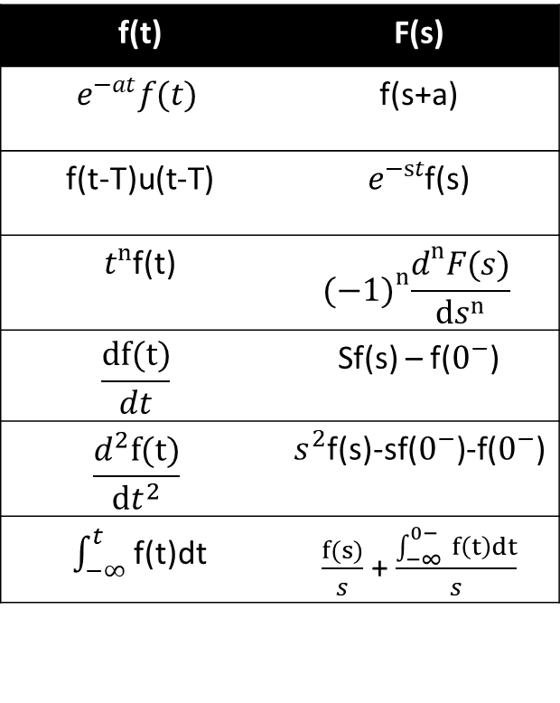
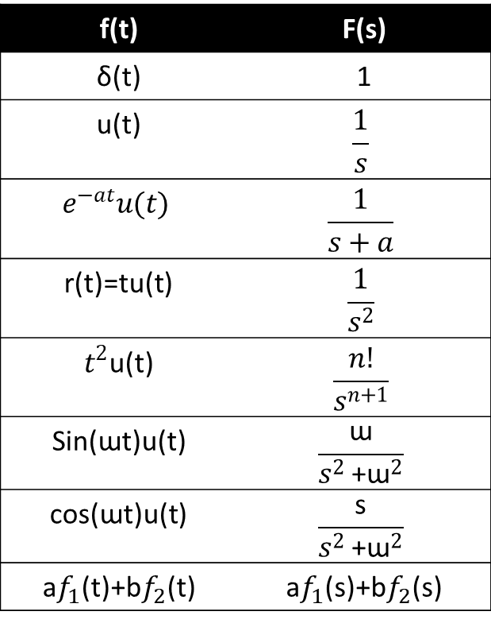
Properties of Laplace Transform
salman
f(t) | F(s)
δ(t) | 1
u(t) | $$\frac{1}{s}$$
$$e^{−at}u(t)$$ | $$\frac{1}{s+a}$$
r(t)=tu(t) | $$\frac{1}{s^{2}}$$
$t^{2}$u(t) | $$\frac{n!}{s^{n+1}}$$
Sin(ɯt)u(t) | $$\frac{\text{ɯ}}{s^{2}{\text{+}\text{ɯ}}^{2}}$$
cos(ɯt)u(t) | $$\frac{\text{s}}{s^{2}{\text{+}\text{ɯ}}^{2}}$$
a$f_{1}$(t)+b$f_{2}$(t) | a$f_{1}$(s)+b$f_{2}$(s)
f(t) | F(s)
$$e^{−at}f(t)$$ | f(s+a)
f(t-T)u(t-T) | $e^{−st}$f(s)
$t^{n}$f(t) | $${(−1)}^{n}\frac{d^{n}F(s)}{ds^{n}}$$
$$\frac{df(t)}{dt}$$ | Sf(s) – f($0^{−}$)
$$\frac{d^{2}f(t)}{dt^{2}}$$ | $s^{2}$f(s)-sf($0^{−}$)-f($0^{−}$)
$\int_{−∞}^{t}{ }$f(t)dt | $\frac{f(s)}{s}$ + $\frac{\int_{−∞}^{0−}{ }f\left(t\right)dt}{s}$

Slide 12
Laplace transform properties and examples
1. Linearity property
The Laplace Transform operation is Linear
For f(t)= a₁ f₁(t )+ a₂ f₂ (t )
L[a₁ f₁(t )+ a₂ f₂ (t )] = a₁L[f₁(t )]+ a₂ L[f₂ (t )] = a₁F₁(s)+ a₂ F₂ (s)
Example 12.6 (p. 557)
Find F(s) when f(t)= K₁ u(t)+ K₂e^{-at} u(t)
Recall LT pairs
Notes:
And Quantitative data can also be Discrete or Continuous:
Discrete data can only take certain values (like whole numbers)
Continuous data can take any value (within a range)
Put simply: Discrete data is counted, Continuous data is measured

Slide 13

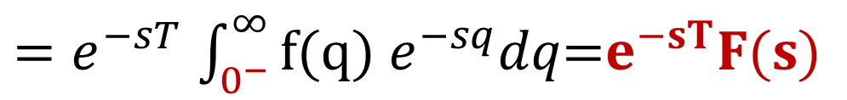
Laplace transform properties and examples
2. Time shift property
If L[f(t )u(t )] = F(s), then, for T>0
L[ f (t − T )u(t − T )] = e^{−sT} F(s)
Proof
As T is constant, then dq = dt

Slide 14
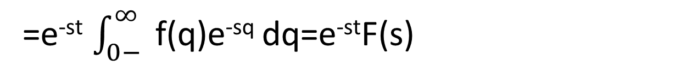
Laplace transform properties and examples
2. Time shift property
If L[f(t )u(t )] = F(s), then, for T>0
salman
L[ f (t − T )u(t − T )] = e^{−sT} F(s)
Proof
F(s)=L[f(t-T) u(t-T)} = $\int_{o−}^{∞}{f\left(t−T\right) e−st dt=\int_{T−}^{∞}{ }f\left(t−T\right)e−stdt}$
As T is constant, then dq = dt
F(s)=$\int_{o−}^{∞}{f\left(t−T\right) u(t−T)e−st dt=\int_{T−}^{∞}{ }f\left(t−T\right)e−stdt=\int_{o−}^{∞}{ }f\left(q\right)e−s\left(q+t\right)dq}$
=e^{-st} $\int_{0−}^{∞}{ }$f(q)e^{-sq} dq=e^{-st}F(s)

Slide 15
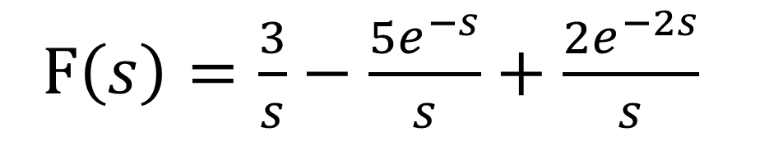
Example 12.7 (p. 559)
Find F(s) for the signal f(t) given in the following figure
f(t)
3
Recall LT pairs
2
1
1
2
t
-1
-2
Notes:
And Quantitative data can also be Discrete or Continuous:
Discrete data can only take certain values (like whole numbers)
Continuous data can take any value (within a range)
Put simply: Discrete data is counted, Continuous data is measured

Slide 16
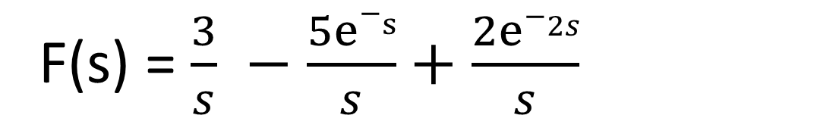
salman
Example 12.7 (p. 559)
Find F(s) for the signal f(t) given in the following figure
f(t) = 3u(t) – 5u(t-1) + 2u(t-2)
f(t)
3
Recall LT pairs
2
F(s) = $\frac{3}{s} −\frac{5e−s}{s}+\frac{2e−2s}{s}$
1
1
2
t
-1
-2
Notes:
And Quantitative data can also be Discrete or Continuous:
Discrete data can only take certain values (like whole numbers)
Continuous data can take any value (within a range)
Put simply: Discrete data is counted, Continuous data is measured

Slide 17
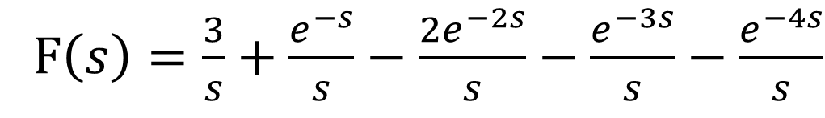
Example 2
Find F(s) for the signal f(t) given in the following figure
f (t ) = 3u(t )+ u(t −1)− 2u(t − 2)− u(t − 3)− u(t − 4)
Recall LT pairs
F$\left(s\right)=\frac{3}{s}+\frac{e^{−s}}{s}−\frac{2e^{−2s}}{s}−\frac{e^{−3s}}{s}−\frac{e^{−4s}}{s}$

Slide 18
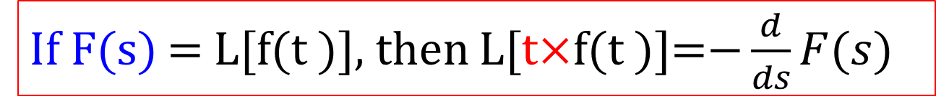
Laplace transform properties and examples
3. Multiplication-by-t property
If F(s) = L[f(t )], then L[t$×$f(t )]=$−\frac{d}{ds}F(s)$

Slide 19
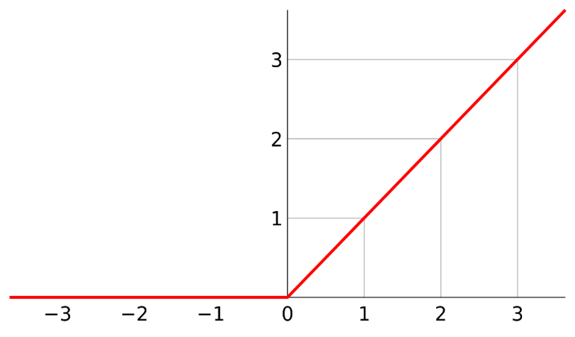
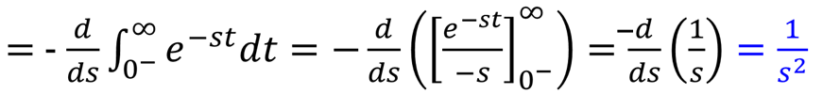
Example 12.8 (p. 560)
Find the Laplace transform of the ramp function R(s)=L[r(t)]
Recall Ramp function

Slide 20
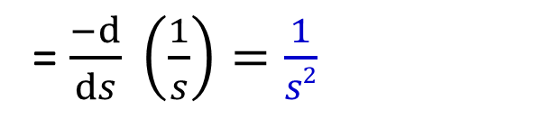
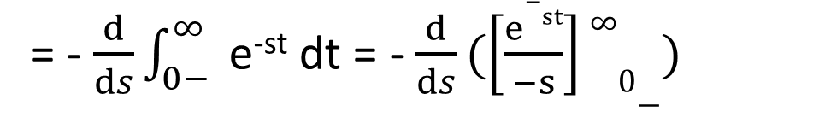
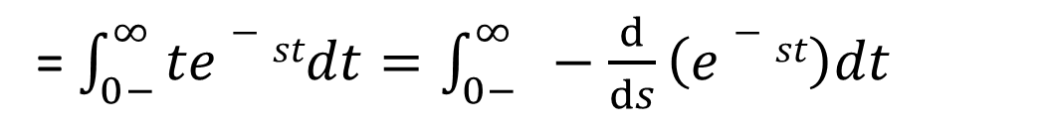
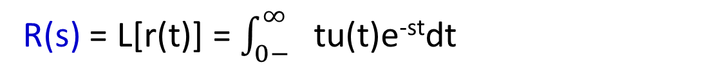
salman
Example 12.8 (p. 560)
Find the Laplace transform of the ramp function R(s)=L[r(t)]
Recall Ramp function
R(s) = L[r(t)] = $\int_{0−}^{∞}{ }$ tu(t)e^{-st}dt
= $\int_{0−}^{∞}{te−stdt=\int_{0−}^{∞}{ }−\frac{d}{ds}\left(e−st\right)dt}$
= - $\frac{d}{ds}\int_{0−}^{∞}{ }$e^{-st} dt = - $\frac{d}{ds}(\left[\frac{e−st}{−s}\right]∞0−)$
= $\frac{−d}{ds} \left(\frac{1}{s}\right)=\frac{1}{s2}$

Slide 21
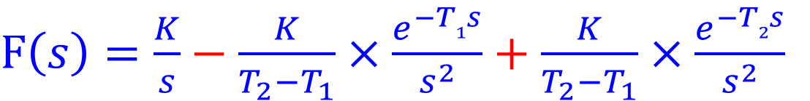
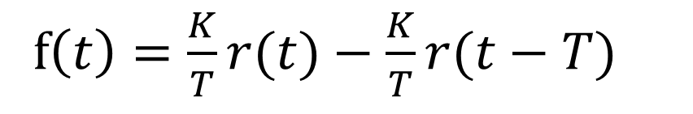
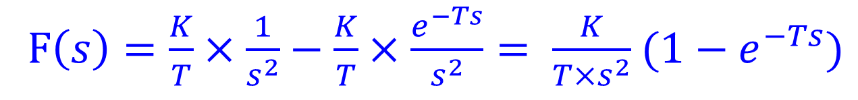
Example 3
Find F(s) for the signal f(t) given in the following figures
A)
f$\left(t\right)=\frac{K}{T}r(t)−\frac{K}{T}r(t−T)$
Recall LT pairs
F$\left(s\right)=\frac{K}{T}×\frac{1}{s^{2}}−\frac{K}{T}×\frac{e^{−Ts}}{s^{2}}= \frac{K}{T×s^{2}}$ ($1−e^{−Ts})$
B)

Slide 22
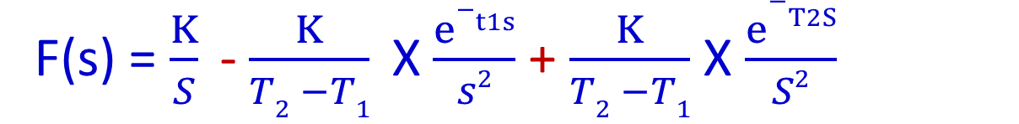
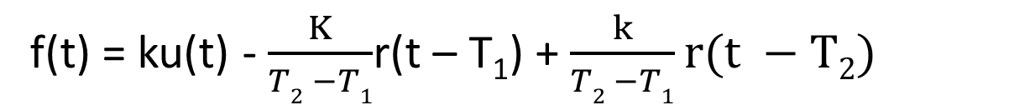
Example 3
salman
Find F(s) for the signal f(t) given in the following figures
A)
f$\left(t\right)=\frac{K}{T}r(t)−\frac{K}{T}r(t−T)$
Recall LT pairs
F$\left(s\right)=\frac{K}{T}×\frac{1}{s^{2}}−\frac{K}{T}×\frac{e^{−Ts}}{s^{2}}= \frac{K}{T×s^{2}}$ ($1−e^{−Ts})$
B)
f(t) = ku(t) - $\frac{K}{T2 −T1}$r(t – T₁) + $\frac{k}{T2 −T1}r(t −T2)$
F(s) = $\frac{K}{S}$ - $\frac{K}{T2 −T1}$ X $\frac{e−t1s}{s2}$ + $\frac{K}{T2 −T1}$ X $\frac{e−T2S}{S2}$

Slide 23

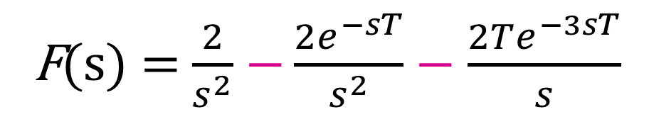

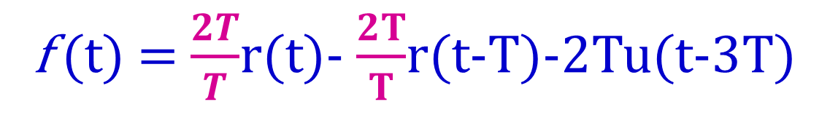




Example 12.10 (p. 561)
$$f\left(t\right)$$
Find F(s) for the signal f(t) depicted in the
following figure
$$2T$$
f (t) = $\frac{2T}{T}$r(t)- $\frac{2T}{T}$r(t-T)-2Tu(t-3T)
$$0$$
$$T$$
$$3T$$
$$t$$
F(s) = $\frac{2}{s^{2}}$ $−\frac{2e^{−sT}}{s^{2}}−\frac{2Te^{−3sT}}{s}$

Slide 24










Example 12.11 (p. 562)
$$I1\left(t\right)$$
Find V_{out}(s) for the following Circuit
$$2$$
+
$$0$$
$$1$$
$$t$$
I₁(t)
I₂(t)
10Ω
V_{out}(t)
$$I2\left(t\right)$$
-
$$1.5$$
$$0$$
$$1$$
$$t$$

Slide 25

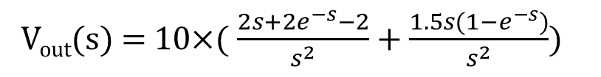

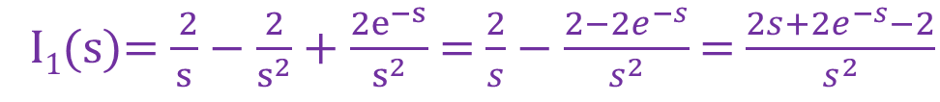





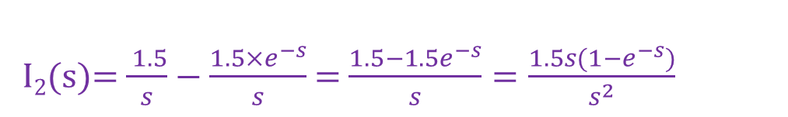



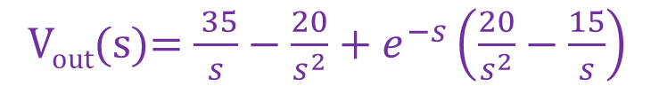
Example 12.11 (p. 562) cont.
V_{out}(t) = 10×(I₁(t)+ I₂(t))
From linearity: V_{out}(s) = 10×(I₁(s)+ I₂(s))
$$I1\left(t\right)$$
$$2$$
I₁(t)=2u(t)-2r(t)+2r(t-1)
I₁(s)= $\frac{ 2}{s}−\frac{2}{s^{2}}+\frac{2e^{−s}}{s^{2}}$ = $\frac{2}{s}−\frac{2−2e^{−s}}{s^{2}}$ = $\frac{2s+2e^{−s}−2}{s^{2}}$
I₂(t)=1.5u(t)-1.5u(t-1)
$$0$$
$$1$$
$$t$$
I₂(s)= $\frac{ 1.5}{s}−\frac{1.5×e^{−s}}{s}$ = $\frac{1.5−1.5e^{−s}}{s}=\frac{1.5s(1−e^{−s})}{s^{2}}$
$$I2\left(t\right)$$
V_{out}(s) = 10×( $\frac{2s+{2e}^{−s}−2}{s^{2}}+\frac{1.5s(1−e^{−s})}{s^{2}}$)
$$1.5$$
V_{out}(s)= $\frac{ 35}{s}−\frac{20}{s^{2}}+e^{−s}\left(\frac{20}{s^{2}}−\frac{15}{s}\right)$
$$0$$
$$1$$
$$t$$

Slide 26
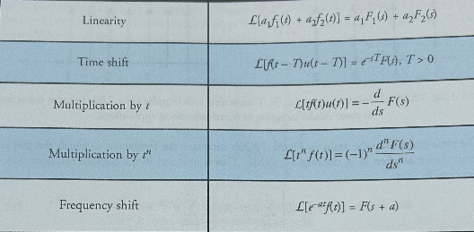
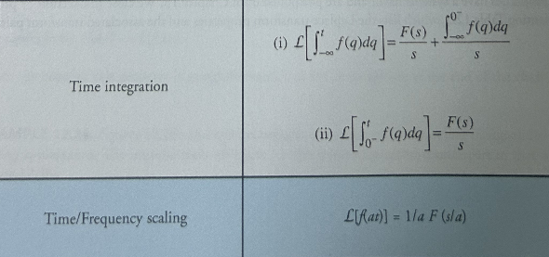
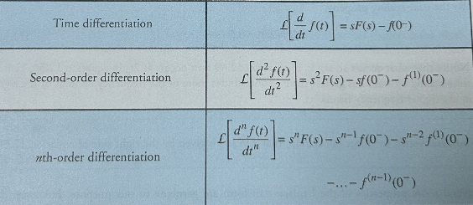
Laplace transform properties (Table 12.2. p.584)

Slide 27
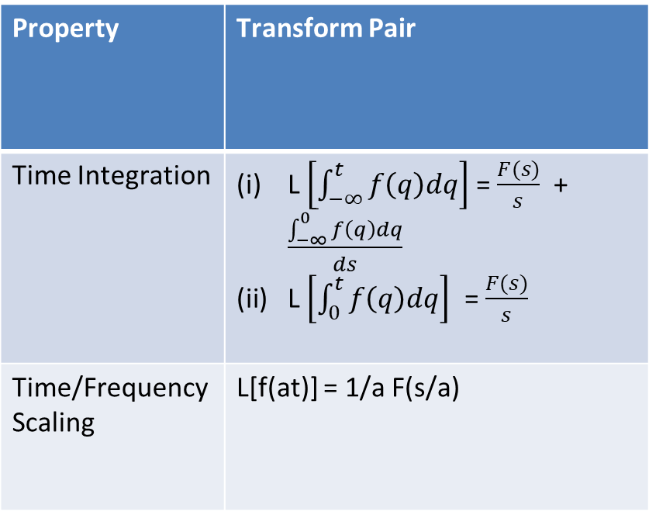
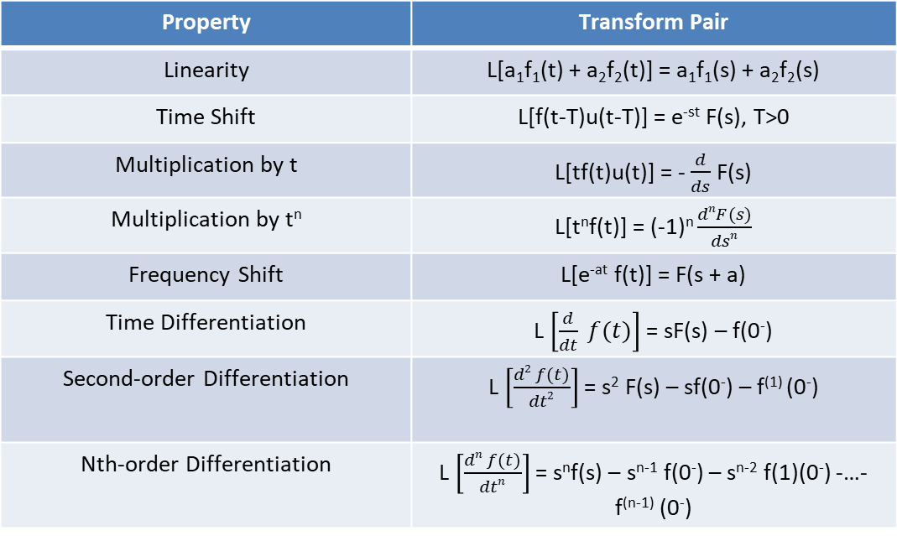
salman
Laplace transform properties (Table 12.2. p.584)
Property | Transform Pair
Linearity | L[a₁f₁(t) + a₂f₂(t)] = a₁f₁(s) + a₂f₂(s)
Time Shift | L[f(t-T)u(t-T)] = e^{-st} F(s), T>0
Multiplication by t | L[tf(t)u(t)] = - $\frac{d}{ds}$ F(s)
Multiplication by t^{n} | L[t^{n}f(t)] = (-1)^{n} $\frac{dnF(s)}{dsn}$
Frequency Shift | L[e^{-at} f(t)] = F(s + a)
Time Differentiation | L $\left[\frac{d}{dt} f(t)\right]$ = sF(s) – f(0⁻)
Second-order Differentiation | L $\left[\frac{d2 f(t)}{dt2}\right]$ = s² F(s) – sf(0⁻) – f⁽¹⁾ (0⁻)
Nth-order Differentiation | L $\left[\frac{dn f(t)}{dtn}\right]$ = s^{n}f(s) – s^{n-1} f(0⁻) – s^{n-2} f(1)(0⁻) -…- f^{(n-1)} (0⁻)
Property | Transform Pair
Time Integration | L $\left[\int_{−∞}^{t}{f\left(q\right)dq}\right]$ = $\frac{F(s)}{s}$ + $\frac{\int_{−∞}^{0−}{f\left(q\right)dq}}{ds}$ L $\left[\int_{0}^{t}{f\left(q\right)dq}\right]$ = $\frac{F(s)}{s}$
Time/Frequency Scaling | L[f(at)] = 1/a F(s/a)

Slide 28
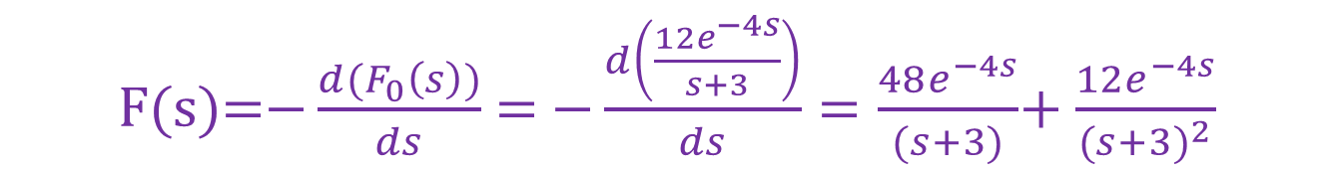
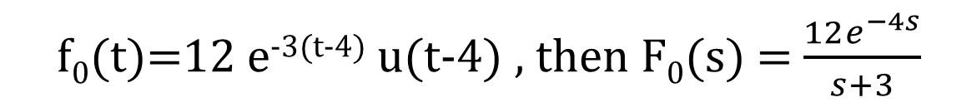
Example 4
Determine Laplace Transform for the following function:
f(t) = 12 t e^{-3(t-4)} u(t-4)
Time Shift Property
f(t) = t×12 e^{-3(t-4)} u(t-4) =t×f₀(t)
f₀(t)=12 e^{-3(t-4)} u(t-4) , then F₀(s) = $\frac{12e^{−4s}}{s+3}$
F(s)=$−\frac{d(F_{0}\left(s\right))}{ds}$ = $−\frac{d\left(\frac{12e^{−4s}}{s+3}\right)}{ds}=\frac{48e^{−4s}}{(s+3)}$+ $\frac{12e^{−4s}}{(s+3)^{2}}$
Time Multiplication Property

Slide 29
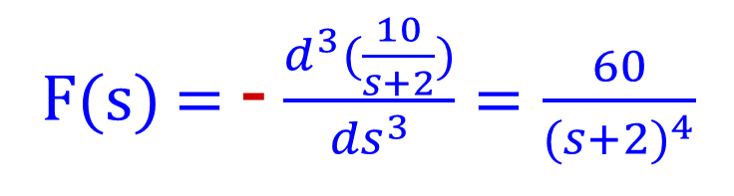
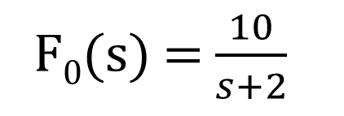
Example 5
Determine Laplace Transform for the following function:
f(t) = 10 t³ e^{-2t} u(t)
f(t) = t³ ×10 e^{-2t} u(t) = t³ × f₀(t)
F₀(s) = $\frac{10}{s+2}$
F(s) = - $\frac{d^{3}(\frac{10}{s+2})}{{ds}^{3}}=\frac{60}{(s+2)^{4}}$

Slide 30
Practice
What is the primary advantage of using the Laplace Transform in circuit analysis?
Explain how the Laplace Transform simplifies solving differential equations.
Explain the time shift property of the Laplace Transform.
What is the multiplication-by-time property of the Laplace Transform?
Explain how the Laplace Transform is applied to analyze circuits in the frequency domain.
Solve activity on Moodle

Slide 31
Summary
Laplace Transform Basics
Transforms time-domain signals into the frequency domain, simplifying the analysis of circuits.
Used to solve differential equations by transforming them into algebraic equations.
Key Properties of Laplace Transform
Linearity
Time Shift
Multiplication by Time
Common Examples
Laplace Transform of Unit Step Function
Laplace Transform of Exponential Function
Delta Function and its Laplace
Applications in Circuit Analysis
Conversion of time-domain circuit equations into the s-domain for easier solution.
Suggested Additional Problems for Ch. 12:
Example 12.25 (p. 585), 12.26 (p. 587) ?

